Slide 1

Chapter 6
Analyzing Cash Flow and Other Financial Information
© McGraw Hill LLC. All rights reserved. No reproduction or distribution without the prior written consent of McGraw Hill LLC.

Slide 2
Cash Flow
Actual cash that flows into the firm minus the cash that goes out of the firm.
Not the same as profit.
Must be sufficient for the proposed business to survive its early days and thrive as an established entity.
Notes:
A new firm must decide whether there will be sufficient cash flow for the proposed business to survive its early days and then thrive as an established entity.
Cash flow is actual cash that flows into the firm minus the cash that goes out of the firm.
It is important to understand that cash flow in a business is not the same as profit. A firm obtains profits when its sales revenue is higher than its expenses.

Slide 3
Cash Flow
Negative cash flow: Carrying inventory of any type results in payments for those supplies taking place long before any cash is received by the business.
Cash crunch worsens when sales grow.
New entrepreneurial business must accurately forecast its real cash flow to prevent a cash crunch.
Notes:
Your customers may have 30 to 90 days to pay, while your suppliers want immediate payment due to your lack of credit history.
Carrying inventory of any type results in payments for those supplies taking place long before any cash is received by the business, resulting in negative cash flow.
This cash crunch is actually exacerbated when sales are growing.
A doubling in orders in a single month sounds great, but it means that twice the inputs must be ordered and paid for while there is no cash coming into the firm to pay for those inputs.
The outcome is that rapid growth by a new entrepreneurial business is actually one of the most dangerous times for that business.
To prevent such a cash crunch, it is important for a new entrepreneurial business to carefully, thoughtfully, and accurately forecast its real cash flow.
In its simplest form, a cash flow statement is a comparison of cash inflows to cash outflows.

Slide 4
Importance of Cash Flow Analysis
Cash flow statement during due diligence stage of the new venture differs from the financial analysis generated by an ongoing firm.
For a proposed business, the focus is on its ability to generate positive cash flow in the shortest possible time.
Viability of the firm will be decided by cash flow, not profitability.
Profit is desirable, but cash pays the bills and the payroll.
Notes:
Learning Objective 6-1: Recognize the fundamental importance of cash flow analysis.
The role of the cash flow statement developed in the due diligence stage of a new entrepreneurial venture is substantially different from the financial analysis developed for an ongoing firm.
For a proposed business, the financial analysis focuses almost exclusively on its ability to generate positive cash flows in the shortest time possible.
For owners of a new entrepreneurial firm, the focus is on the viability of the business, and the viability of the firm will be decided by cash flow, not profitability.
The ability of the new business to generate strong profits on each item sold is indeed important; however, profit should not be the principal focus in the analysis of a potential new business.
Profits have little to do with whether the business will be viable over the long term.
Of course, an entrepreneur wants to make a profit, but cash pays the bills and the payroll.

Slide 5
Budget
Statement that projects all the costs that will be incurred by the organization over a period of time and allocates those expenses evenly over the relevant time period.
Should not be confused with cash flow statement.
Helpful, but one needs to know the amount of cash they need to pay the bills.
Notes:
Learning Objective 6-1: Recognize the fundamental importance of cash flow analysis.
A cash flow statement is not a budget and should not be confused with a budget.
A budget projects all the costs that will be incurred by the organization over some period of time (a year, for instance) and allocates that expense evenly over the relevant time period.
An example might be an insurance payment. The annual cost might be $1,800; thus, the budget would reflect $150 per month.
A cash flow statement does the exact opposite of a budget. In the example of an insurance payment, in each month in which no actual cash outflow occurs, the category receives a zero, and then in the month that the payment is due, the account will record a cash outflow of $1,800.
Although budgets are helpful for planning purposes, nothing brings home reality like the recognition that the company must have X amount of actual cash in order to pay this month’s bills.

Slide 6
Developing Cash Flow Statements and Budgets
Cash flow statement for a new business is much different from one generated by a publicly traded corporate annual report.
Cash flow statement is used to describe all of the activities that provide and use cash during the period being examined.
Long-term track record of cash flow statements assists in loans or credit lines, infusions of equity capital, and valuation if the owners choose to sell the company.
Notes:
Learning Objective 6-2: Prepare a cash flow statement and a budget.
There are several key issues that should be noted in developing a cash flow statement.
The first is that a cash flow statement for a new business is substantially different from the typical publicly traded corporate annual report that you may have seen.
New businesses, unlike established companies, are unlikely to have either investing activities or financing activities (interest on notes/loans is included in the operations section of new business cash flow statements).
New entrepreneurial ventures typically have only one type of activity: operations.
Everything that involves cash in/cash out is related to the operation of the business.
The cash flow statement is used to describe all of the activities that provide and use cash during the period being examined.
The authors recommend that the statement be done monthly until the business is well established.
As the business grows, a well-developed, accurate long-term track record of cash flow statements and the comparison of the planned cash flows to reality will go a long way toward assisting the company with loans, credit lines, infusions of equity capital, and even valuation should the businessperson want to sell the company.

Slide 7
Generating the Cash Flow Statement: Begin with Expenses
Salaries.
Basic benefits.
Taxes or fees: Payroll, income, local, state, business, and licenses.
Cost of goods sold: Manufacturing or development, packaging, direct labor, shipping.
Utilities.
Security systems.
Tools or machinery, or computers.
Notes:
Learning Objective 6-2: Prepare a cash flow statement and a budget.
Generating the cash flow statement should actually begin with the expenses of the organization, for the very simple reason that they are easier to accurately forecast than are revenues.
Expenses fall into a number of categories that are inclusive of, but not limited to, the following list:
Salaries
Basic benefits
Taxes/fees
Payroll
Income
Local
State
Business
Licenses
Cost of goods sold
Manufacturing/Development
Packaging
Direct labor
Shipping
Utilities (electricity, gas, phone service, etc.)
Security systems
Tools/machinery/computers

Slide 8
Generating the Cash Flow Statement: Begin with Expenses
  Office supplies
  Travel expenses
  Insurance
  Advertising
  Furniture
  Cell phones
  Maintenance of equipment
  Cleaning
  Rent or mortgage payments
Notes:
Learning Objective 6-2: Prepare a cash flow statement and a budget.
Office supplies (a big and often underestimated expense)
Travel expenses
Insurance
Advertising
Furniture
Cell phones
Maintenance of equipment
Cleaning (either a service or supplies for your use)
Rent/mortgage payments
In short, all actual expenses must be accounted for in the cash flow statement.
If your specific business has unique expenses that do not fit into these categories, note that you also need to add those expenses to this list.

Slide 9
Other Financial Tools
Pro forma: Term describing estimates of what the balance sheets and income statements will look like in the future.
Balance sheet: Summary of the assets and liabilities of the entrepreneurial business.
Notes:
Learning Objective 6-3: Identify other financial tools.
The focus thus far in this chapter has been exclusively on cash flow.
However, there are other financial tools that are very helpful in analyzing a new business idea.
A new business will likely want to create pro forma balance sheets and income statements.
The term pro forma (Latin, meaning “as a matter of form”) simply means that the entrepreneur estimates what the balance sheets and income statements will look like in the future, in order to plan well.
A balance sheet is a document that summarizes the assets and liabilities of the entrepreneurial business at one point in time.

Slide 10
Balance Sheet: Assets
Current assets: Assets such as cash or those assets that can easily be converted to cash, such as accounts receivable and notes receivable.
Fixed assets: Assets that have a physical presence, including land, buildings, office equipment, machinery, and vehicles.
Notes:
Learning Objective 6-3: Identify other financial tools.
There are two basic types of assets that should be included as separate items in the balance sheet
Current assets: Assets such as cash or those assets that can easily be converted to cash, such as accounts receivable and notes receivable.
Fixed assets: Assets that have a physical presence, including land, buildings, office equipment, machinery, and vehicles.
The balance sheet should include separate lines for each relevant type of current and fixed asset.

Slide 11
Balance Sheet: Liabilities
Current liabilities:
Liabilities or debts that the entrepreneurial business has to pay within one year.
Include accounts payable, notes payable such as bank notes, and accrued payroll.
Long-term liabilities:
Liabilities that are owed by the business and are ultimately due more than a year from the current date.
Include mortgages payable, owners' equity, and stockholders' equity.
Notes:
Learning Objective 6-3: Identify other financial tools.
On the other side of the equation there are two types of liabilities: current liabilities and long-term liabilities.
The definitions of these two types of categories and explanations of what constitutes each are as follows:
Current liabilities: Liabilities or debts that the entrepreneurial business has to pay within one year. These include accounts payable, notes payable such as bank notes, and accrued payroll.
Long-term liabilities: Liabilities that are owed by the business and are ultimately due more than a year from the current date. These include mortgages payable, owners’ equity, and stockholders’ equity (the latter two are the investment by these individuals in the business).

Slide 12
Balance Sheet
Snapshot of a business at one point in time.
Assets minus the liabilities should total to zero.
Assets and liabilities balance each other.
Working capital: Current assets minus current liabilities.
Notes:
Learning Objective 6-3: Identify other financial tools.
The assets minus the liabilities of the firm reflected in the balance sheet should total to zero.
Thus, the assets and liabilities balance each other.
A balance sheet is a snapshot of a firm at some point in time.
The current assets minus the current liabilities are referred to as the working capital, which is in effect the liquid assets the firm could call upon quickly to meet needs that arose.

Slide 13
Balance Sheet Example
Assets | In dollars
Total Current Assets | 50,000
Total Fixed Assets | 340,000
Total Assets | 390,000
Liabilities | In dollars
Total Current Liability | 54,500
Total Long-Term Liability | 200,000
Owner’s Equity | 135,500
Total Liabilities/Owner’s Equity | 390,000
The following content is arranged like a table.
Notes:
Learning Objective 6-3: Identify other financial tools.
Table 6.7 shows the balance sheet for a small manufacturing firm.
Notice the total assets equal the total liabilities/owner’s equity. The sides balance each other.

Slide 14
Income Statement
Revenue of the firm minus expenses.
Focus is on profit rather than cash flow.
Predicting sales for the entrepreneurial firm is a key to developing an income statement.
Provides both the gross and the net profit figures.
Gross profit equals sales minus cost of goods sold.
Gross profit minus all expenses equals net profit before taxes.
Estimated taxes are calculated and subtracted from net profit.
Notes:
Learning Objective 6-3: Identify other financial tools.
A pro forma income statement projects the future income of an entrepreneurial firm.
The focus of the income statement is profit rather than cash flow.
One of the keys to developing an income statement is predicting sales for the entrepreneurial firm.
The ability to talk with entrepreneurs in the same domain against whom you will not compete is an excellent source of information. These same individuals are excellent sources of information on what sales levels could be expected at various stages in the growth of new business. The key is to be conservative, because the reality is that things never happen as fast or as smoothly as you would hope in founding your business.
The income statement provides both the gross and the net profit figures for the firm.
In its simplified form, gross profit generally equals the sales of the organization minus the cost of goods sold.
Gross profit minus all other expenses yields net profit before taxes.
Lastly, estimated taxes are calculated and subtracted from net profit, to determine the company’s net profit after taxes.

Slide 15
Break-Even Analysis
  Tool for the estimation of when a business’s income exceeds its expenses.
  Fixed costs: Costs that must be paid no matter how many goods are sold, such as rent for the building.
  Variable costs: Costs that vary according to how many goods are produced.
Notes:
Learning Objective 6-3: Identify other financial tools.
Individuals have numerous alternatives to starting a new venture, and the authors suggest that a break-even analysis of the projected position of the company will go a long way toward determining not only the viability of the new venture but also the realistic assessment of whether this is the best path for the entrepreneur to embark upon.
A break-even analysis provides some judgment about when the firm will reach a point of being self-sustaining after the business is begun.
The break-even analysis recognizes that the growth in sales does not occur all at once.
Instead, the sales of the business will grow incrementally once the firm starts.
However, many of the expenses of the firm will start months before the first sale.
Specifically, fixed costs (for example, rent, utilities, equipment leases) must be paid regardless of the sales level.
There are also variable costs that will fluctuate according to how many goods are produced.

Slide 16
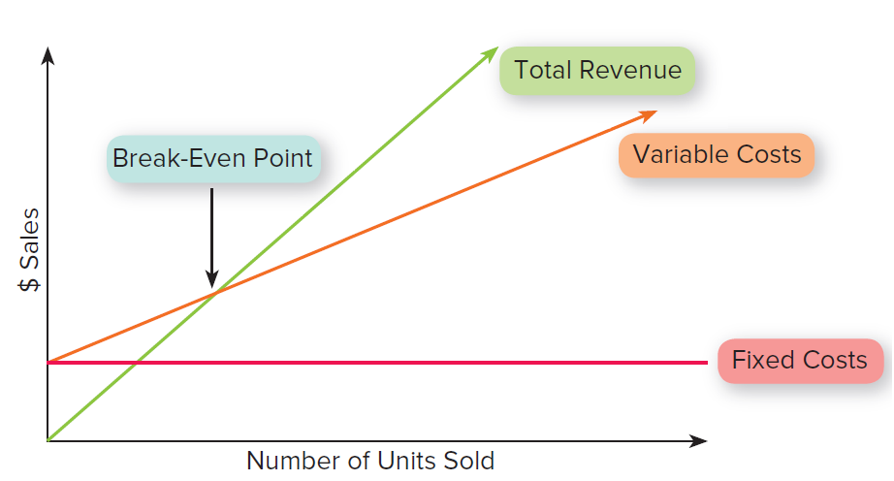
Classic Break-Even Diagram
Notes:
Learning Objective 6-3: Identify other financial tools.
The traditional Fortune 500 approach to break-even analysis would suggest that once revenues exceed the total of the fixed costs plus the variable costs, the firm has reached breakeven.
In this approach, the profit margin from each sale adds to the net profit for the firm.
For firms operating in a project-by-project environment, this type of analysis is relatively effective.
These firms are simply trying to compare an investment in one project to an investment in another, as shown in Figure 6.1.

Slide 17
Finance Tool Kit
Entrepreneurship Finance Tool Kit Link

